Slide 1


ITVM SEC - 33
Project Title: Technical
RecyclingBin.in

Slide 2


Who we are
Place your venture logo here
Name of your Venture: Technical Recycling Product
1) Explain why do you want to pursue this Business Idea.
Technical RecyclingBin.com
I have selected this project because in this case we can recycle the waste mechanical products by recycling it and reutilize it by the given product according to the given condition.
2) Provide a brief on what does your venture do.
Our venture is used to convert the source of the mechanical data by recycling and reutilize the things in the given products data of the given condition.
3) Explain how your venture solves the problem and make its revenue.
As we gather data and formulate the challenge. Then, explore ideas and come up with the solutions. Develop a plan of action.

Slide 3
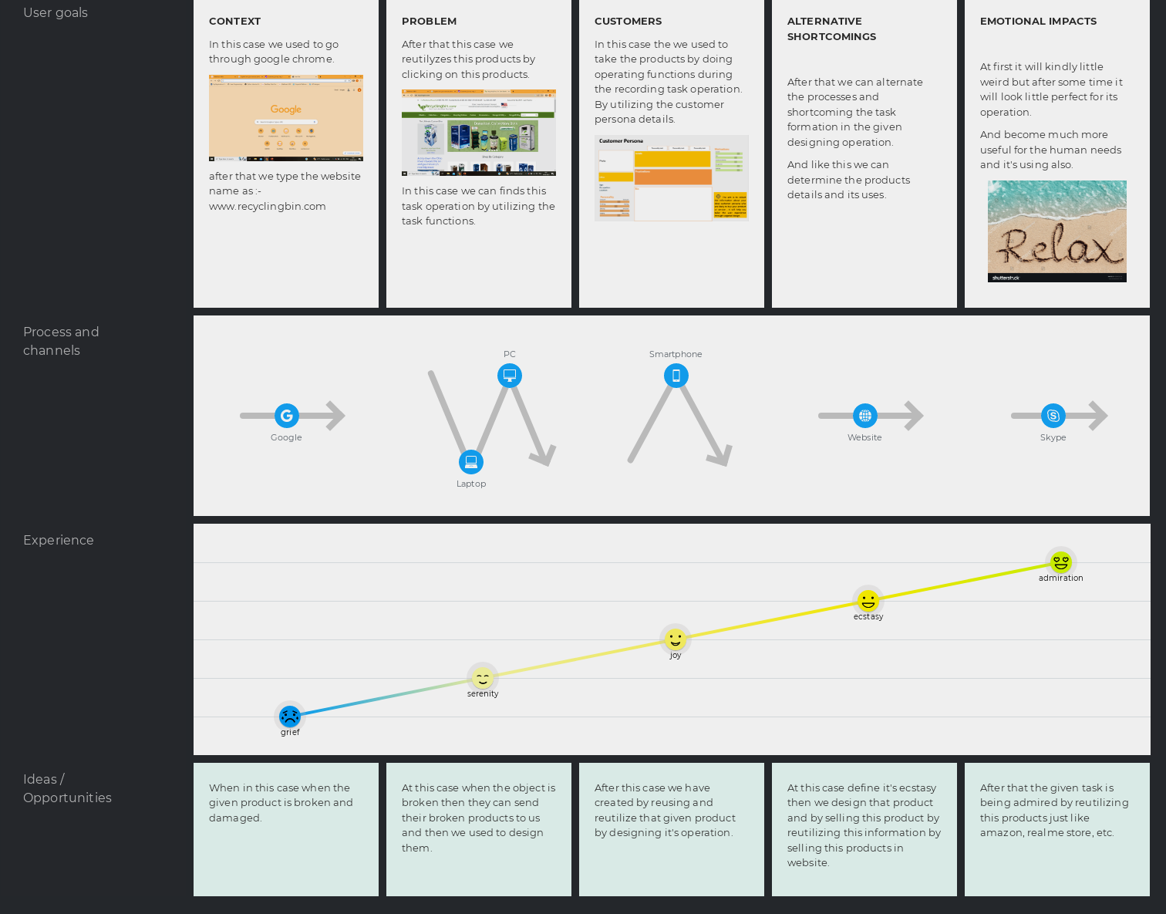
Problem/Opportunity
Technical RecyclingBin.com
This table helps you define the problem and existing market gaps.
And it also says about the graph of our company user.

Slide 4

Problem Interviews And Surveys Results
How many customers did you interview?
We have taken the interview for every peoples in different society and also wanted to critify and satisfied their needs.
What was the interview mode?
The interviews were conducted in both offline and virtual modes.
How many of them agree this is a problem and wants a solution?
80% of the peoples/students agreed with our product and expressed a desire for a solution.
How many of them said they don't need a new solution?
20% of the customers mentioned that they don't need a new solution because they either have their own thoughts in this details.
Technical RecyclingBin.com
The aim of this slide is to capture the customer responses to substantiate and validate the problem your venture is solving. Present result analysis of the problem interviews conducted with your potential customers in graphical representation.

Slide 5
Market Size Estimation
Topic of the discussion:
In this case we will first take the broken things like refrigerator, washing machine, alarm clocks, etc. from the users.
Then we will reuse its configuration and design the products accordingly and after that we used to create the rate amount price for the products association by estimating its market size.
We used to sell all the recycled products we used to make by using online shopping process in our official website : www.recyclingbin.com.
In this we mostly recycle the technical products only more than non-technical products.
Like this our process of recycling and the selling of product is used to be done.
Technical RecyclingBin.com
Recycling the mechanical products
Reutilize by manufacturing that technical products
In this we will take the waste product from the customers and give them the amount according to the raw prices.
.
Sources: RecyclingBin.com

Slide 6
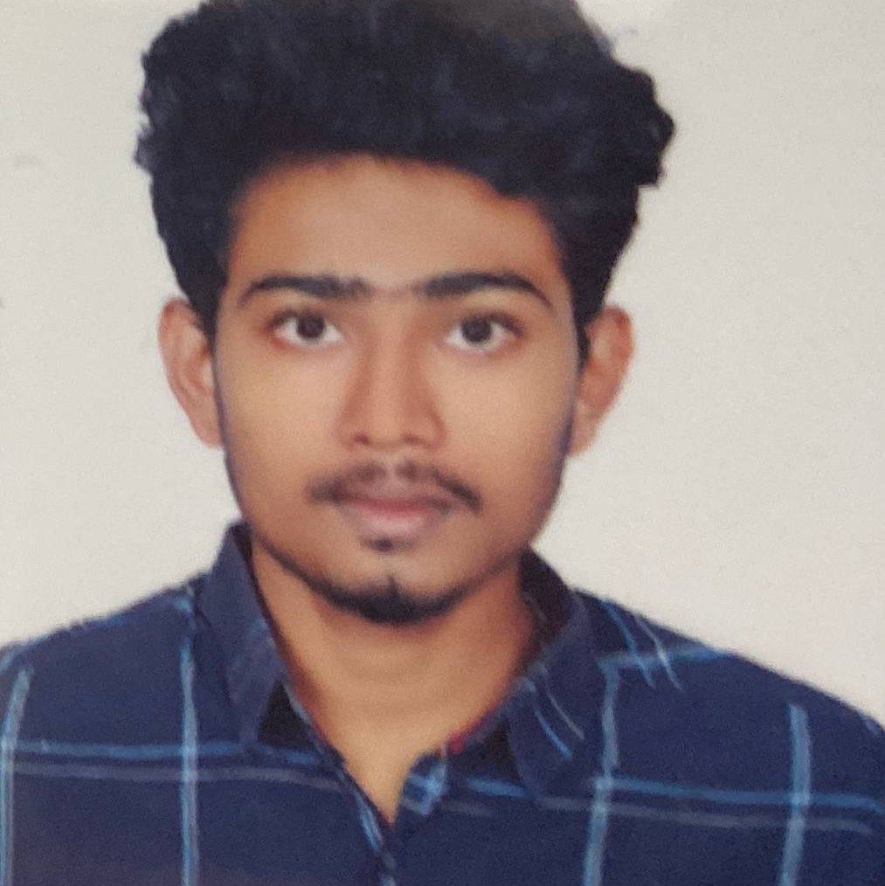
Customer Persona
Tech-Savvy
Community Engagement
Adaptive
Photo
Goals
Safety, Convenience, Academic Success, Budget Conscious,
Environmental Consciousness
Motivations
Frustrations:
Like to get thing broken or expenses product become useless within few days and not useful also and having willingness to buy products with less amount.
Ethos
Age: 19
Occupation: Student
Location: Tenali
Bio
Soma Sekhar is a junior engineer from S. S. S. V company. Where he is facing maximum time problems in laptop while evaluating or while working due to which he has spend lots of money for that useless functional product. So, that’s why his one friend has recommend our company and benefits he immediately contact us said his problem which we have solved his problem after that he was very happy and relaxed with less budgets from our benefits.
The aim is to collect the information about your ideal customer persona who are likely to buy your product or service . It will help you tailor the user experience through targeted design.
Personality
Notes:
Time: 7 mins
Get students to brainstorm on the customer persona and VPC

Slide 7
Value Proposition Canvas
Place your logo here
.
What do you offer that makes the customers happy?
Customers used to be very happy for our work and used to praise us for getting more achievements in our daily life.
I would LOVE it if:
? What would make the customer happy?
? What do the clients want when facing the problem?
This refers to the feeling/action of customers before he gets in contact with your solution.
What is the product or service that we are offering?
We used to sell or those recycled products the needful users or if that same customer who used to sell that given utilities to us and wanted to get returned back his/her products then we used to give them back.
FIT
I would WANT:
What do the clients do (actions) when facing the problem?
This refers to the feeling/action of customers before he gets in contact with your solution.
GAIN CREATORS
GAINS
PRODUCT/
SERVICE
JOBS
PAIN KILLERS
PAINS
Which features of your offering relieve the customer's pains?
At first they feel various unusual things about us but after that they get satisfied with their needs by getting their recycled products and which become more useful for their needs and recommendations.
I would HATE it if:
What are the pains of the clients when facing the problem?
This refers to the feeling/action of customers before he gets in contact with your solution.

Slide 8

Competition Analysis
Place your logo here
Benefits | Competitor 1 | Competitor 2 | Competitor 3 | Competitor 4 | Your Venture
Product | Offers a wide range of bus services, including express, semi-express, and sleeper buses | Offers a more limited range of bus services, but focuses on luxury and comfort | Offers a niche bus service, such as airport transfers or shuttle buses | Offers a more limited range of bus services, but focuses on luxury and comfort | Offers a variety of bus services to meet the needs of different customers, including express, semi-express, sleeper, and luxury buses
Price | Prices are generally competitive with other bus companies | Prices are slightly higher than other bus companies, but the buses are more luxurious and comfortable | Prices are lower than other bus companies, but the buses are not as luxurious or comfortable | Prices are generally competitive with other bus companies | Offers a variety of pricing options to meet the needs of different customers, including discounts for students, seniors, and groups
Branding channels | Uses a variety of branding channels, including social media, online advertising, and print advertising | Focuses on online branding and advertising | Has a strong focus on offline branding and advertising | Focuses on online branding and advertising | Uses a mix of online and offline branding and advertising
Packaging | Tickets are sold online and at bus terminals | Tickets are sold online and at bus terminals, but the company also offers a ticket delivery service | Tickets are sold online and at bus terminals, but the company also offers a bus pass program | Tickets are sold online and at bus terminals, but the company also offers a ticket delivery service | Offers a variety of ticket options, including e-tickets, mobile tickets, and paper tickets
Market reviews | Market reviews are generally positive, with customers praising the wide range of services and competitive prices | Market reviews are mixed, with some customers praising the luxury | Market reviews are positive, with customers praising the convenience of the niche service | Market reviews are mixed, with some customers praising the luxury | Market reviews are positive, with customers praising the variety of ticket options and competitive prices
UVP | Is a one-stop shop for all bus travel needs | Offers a luxurious and comfortable bus travel experience | Offers a convenient and affordable niche bus service | Offers a convenient and affordable niche bus service | Offers a variety of bus services and ticket options to meet the needs of different customers

Slide 9
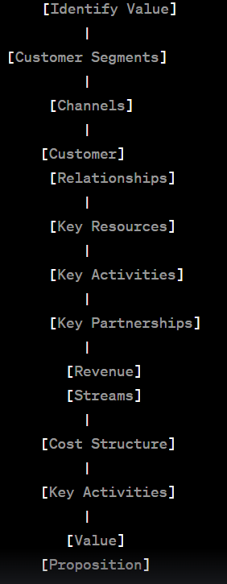
Lean Canvas
Place your logo here
UNIQUE VALUE PROPOSITION
The unique value proposition (UVP) for on-demand bus tracking and transportation service app “Technical RecycleBin.in" lies providing a distinct and compelling set of benefits and features that set it apart from competitors and address the specific needs of users. Here's a potential UVP for such an app:
"TechnicalRecycleBin.in : in this app the users can contact to give their broken machines to get repaired “
HIGH-LEVEL CONCEPT
TechnicalRecycleBin.in is a best
solution for getting their technical things repaired and their working with the proper and usefull manner.
CUSTOMER SEGMENTS
Students
Faculty and Staff
Visiting Scholars and Guests
Parents and Visitors
University Administrators
International Students
EARLY ADOPTERS
Tech-Savvy Students
Student Transportation Committees
University Ambassadors and Tour Guides
Faculty and Staff Transportation Advocates
University Administrators
Transportation Departments
PROBLEM
Users now a days always used to throw the plastic wastes and other chemical wastes at every where due to which leads to more amount of pollution in our today’s society that’s why we have created this app to help the peoples who’s things are broken they can contact us and solve their problem.
EXISTING ALTERNATIVES
Mechanical Sorting Sys.
Chemical Recycling
Text Message Alerts
Word of Mouth
Smart Bins
SOLUTION
Develop a user-friendly mobile app for both Android and iOS platforms. So, that the users can give their broken technical thing and can get repaired by which they can able to use that same thing without any problem facing in between them.
UNFAIR ADVANTAGE
Exclusive Data Sources
University Partnerships
Customer Support Excellence
Business Model
CHANNELS
Mobile App Stores
University Website
Social Media
University Events
Student Ambassadors
Online Advertising
Partnerships
KEY METRICS
On-Time Performance
Accuracy of Arrival Predictions
User Satisfaction
COST STRUCTURE
Development Costs
Technology Infrastructure
Operational Costs
Transaction and Payment Processing Fees
REVENUE STREAMS
Subscription Fees
Advertisement and Sponsorship
University Partnerships
Event Transportation Services
This canvas explains how the venture makes money (attracts, serves and keeps customers)

Slide 10
MVP Validation
Place your logo here
Validating the Minimum Viable Product (MVP) of a Recycle Project Management system is essential to ensure that the project meets its objectives and is on the right track. Here are steps to validate your MVP effectively:
Define MVP Objectives
Identify Key Metrics
User Feedback
Iterate Based on Feedback
User Adoption and Engagement
Documentation and Training
Communication and Reporting
End-User Testing
The validation of the MVP for your Recycle Project Management system is an iterative process. It's essential to continuously gather feedback and data, make improvements, and adapt to changing project needs and user requirements. This approach will help ensure the project's success and its alignment with the goals of improving recycling efforts and sustainability.
The slide helps to see your vision in action with a clear demonstration

Slide 11
Sales Plan
Customer Acquisition Plan
Customer Sales Funnel
1 | 2 | 3 | 4 | 5
Target Customer Segment (Type) | Target Customer Segment (Number) | Channels to be used to attract the target customer segment | Estimated number of leads | Estimated cost to convert these leads to actual customers
Commuters | 100,000 | Online advertising, social media marketing, public relations | 20,000 | $10 per customer
Students | 50,000 | Partnerships with corporations, online advertising, travel agency | 10,000 | $20 per customer
Tourists | 25,000 | Online advertising, travel agency partnerships, social media marketing | 5,000 | $15 per customer
Corporate travelers | 10,000 | Partnerships with corporations, online advertising | 2,000 | $20 per customer
Seniors | 5,000 | travel agency partnerships, social media marketing | 1,000 | $5 per customer
People with disabilities | 5,000 | discounts for people with disabilities | 1,000 | $5 per customer
Groups | 10,000 | Partnerships with event organizers, online advertising | 2,000 | $15 per customer
TARGET MARKET:
Content Marketing
Online Presence
OPPORTUNITIES/PROSPECTS
Social Media Followers
Email Subscribers
Website Visitors
CUSTOMER:
Order Fulfillment
Gathering Feedback
Transaction
INTERESTS:
Educational Content: Offer informative content on your website and social media platforms about the nutritional value of your meals and the importance of balanced eating.
Notes:
Evaluation Criteria for slide 20 to 22
1. Does the venture have a Sales projections sheet with monthly sales targets and customer funnel defined for the next one year? (2 marks) 2. Does the venture have an active social media presence, such as FB, Instagram, LinkedIn? (1 mark) 3. Do you have a well-thought out brand name, logo, and a Positioning statement? (1 mark) 4. Have you made an actual sale? (1 mark)

Slide 12
Go-to-Market Strategy
Ensure that you have active social media presence on multiple platforms – Facebook, LinkedIn, Instagram, Twitter, and others.
Show your branding video. Ensure that it:
Is crisp and engaging
Clearly explains the brand, the venture, its target customers, and unique value proposition.
Show your Positioning Statement. Ensure that it clearly states what your product is and what value it brings to the customer
Action plan to reach your sales/customer target for the next one year.
Show your Sales & Distribution model, clearly listing down your channels for both sales and distribution.
Note: You may use any other template of your choice to pitch for your venture as long as you cover all information being sought here.

Slide 13
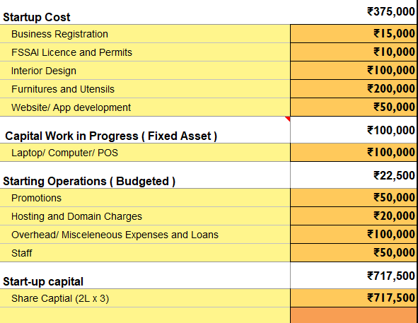
FINANCIAL PLAN
Start-up Costs
Place your logo here
Explanation:
Capital work in progress (fixed asset): This is the cost of purchasing or leasing buses and other fixed assets.
Laptop/computer/POS: This is the cost of purchasing laptops, computers, and other point-of-sale systems.
Promotions: This is the cost of marketing and promoting the company.
Hosting and domain charges: This is the cost of hosting the company's website and domain name.
Overhead/miscellaneous expenses and loans: This includes the cost of other miscellaneous expenses, such as insurance and office supplies.
Initial design: This includes the cost of designing the company's website, mobile app, and other marketing materials.
Business registration: This includes the cost of registering the business with the relevant government authorities.
Notes:
Evaluation Criteria for slide 24
1. Have you done their Unit Economics and come up with CAC, CLV, ARPU, Net and Gross Profit? (1 mark) 2. Do you have a plan on how to reduce their CAC and churn rate, and increase their CLV, ARPU, and Net Profit Margin? (2 marks) 3. Is the capital asked for as per the Funding plan in line with the business? (1 mark) 4. How long will it take you to return the investment? (1 mark)

Slide 14
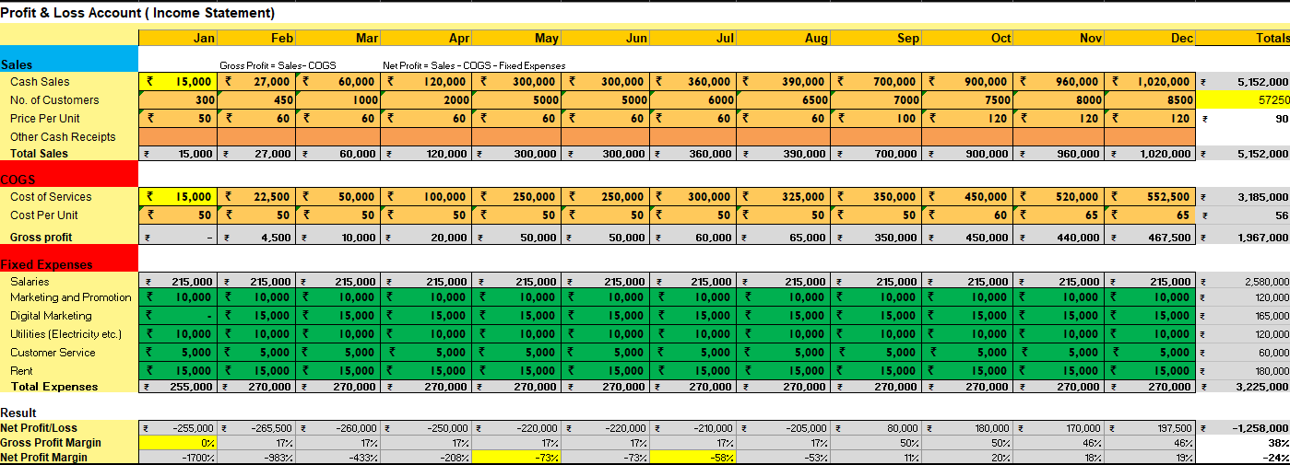
Forecast P&L
Place your logo here
Explanation: The company's growth plans: If the company is planning to grow rapidly, it may need to reserve more shares for future employees and investors.
The company's financial situation: If the company is struggling financially, it may need to limit the number of shares it allocates to employees and investors.
The company's culture: The company should consider what kind of culture it wants to create. If the company wants to create a culture of ownership, it may want to allocate more shares to its employees.
Notes:
Evaluation Criteria for slide 24
1. Have you done their Unit Economics and come up with CAC, CLV, ARPU, Net and Gross Profit? (1 mark) 2. Do you have a plan on how to reduce their CAC and churn rate, and increase their CLV, ARPU, and Net Profit Margin? (2 marks) 3. Is the capital asked for as per the Funding plan in line with the business? (1 mark) 4. How long will it take you to return the investment? (1 mark)

Slide 15
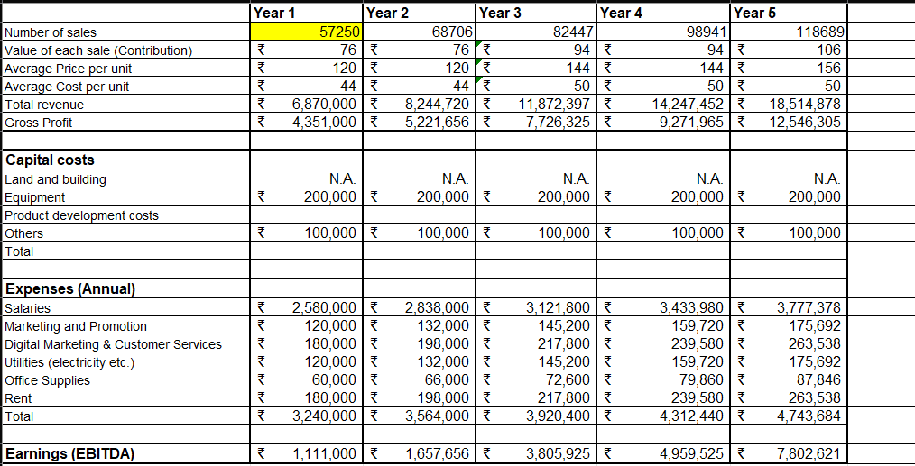
Financial Projections
Place your logo here
Notes:
Evaluation Criteria for slide 24
1. Have you done their Unit Economics and come up with CAC, CLV, ARPU, Net and Gross Profit? (1 mark) 2. Do you have a plan on how to reduce their CAC and churn rate, and increase their CLV, ARPU, and Net Profit Margin? (2 marks) 3. Is the capital asked for as per the Funding plan in line with the business? (1 mark) 4. How long will it take you to return the investment? (1 mark)

Slide 16
Unit Economics
P & L/ unit | Year (2022-23)
Revenue | Rs. 32,000/-
COGS | Rs. 14,000/-
Gross Profit | Rs. 2500/-
Gross Profit Margin | Rs. 1,20,000/-
Operating Costs | Rs. 3500/-
Operating Profit | Rs. 45,000/-
Unit Economics | Year (2022-23)
CAC | Rs. 54,000/-
CLV | Rs. 6000/-
ARPU | Rs. 30,000/-
The above is the Unit Economics for year 1 (year 2022-23). Refer to P&L statement for year 1 in slide 15.
​Terms | Explanation (For the actual calculations, refer to the Financial Plan Excel sheet link)​
CAC​ | (Cost of Sales + Cost of Marketing ) / Number of new customers acquired (in currency terms)​
CLV | Average purchase value x Average purchase frequency x Average Customer Lifespan x Gross Margin
ARPU​ | Total revenue in specific period/Total number of customers during the same period (in currency terms)​
GROSS PROFIT​ | Total revenue – Total COGS (In currency terms)​
OPERATING COSTS | Cost of goods sold (COGS) + operating expenses (OPEX)
OPERATING PROFIT | Revenue from Core Operations – Cost of Goods Sold – Operating Expenses – Depreciation – Amortization Expenses
CURRENT RATE | (Customers at the beginning of the period – customers at the end of the period) / customers at the beginning of the period

Slide 17
Funding Plan
How much funds required to reach to the next level of the venture?
We must require Rs. 20 lakh/- per annum to reach next level.
How much have been bootstrapped? If not, why ?
If you're interested in the funding details of a specific technical recycling project, I recommend checking recent reports, press releases, or official statements.
How much can be bootstrapped?
The amount that can be bootstrapped for a technical recycling project can vary significantly based on various factors.
How much external funding required? If not, why?
To determine the exact amount of external funding required, organizations undertaking detailed feasibility studies and financial analyses.
Funds utilization strategy (Details)
Project Planning and Assessment.
Research and Development.
Infrastructure Development.
Training and Capacity Building.
Quality Control and Monitoring Systems.
Community Outreach and Education.
Waste Collection and Transportation.
Regulatory Compliance and Certification.
Continuous Improvement and Innovation.
Technology Acquisition.
Notes:
Evaluation Criteria for slide 19
1. Have you identified how much fund you need to reach the next level for the venture? (1 mark) 2. Have you bootsrapped any money till now? How much can they bootstrap?(1 mark) 3. Do you need external funding? Why or why not? (1 mark) 4. Can you explain clearly how you will utilize the money tomorrow if they get the funding today? (2 marks)

Slide 18
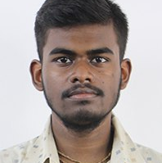
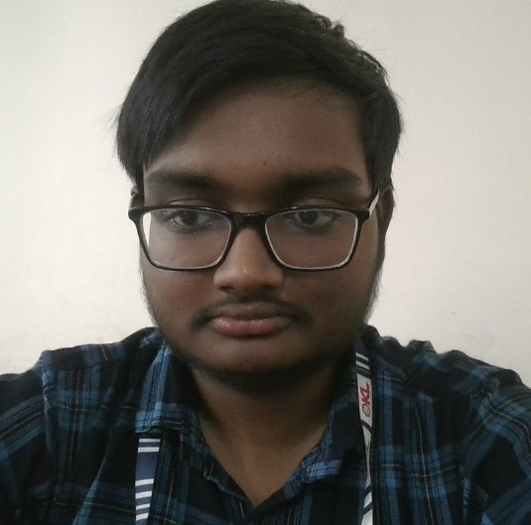
Meet our team
Id no. : 2100032541
Id no. : 2000030014
Id no. : 2100032103
Nanda Kishore Jana
Archit Kumar​
P. Bhanu Teja
Chief Executive and recycle task manager
Leader and President
Of our management
Chief Operating Officer
Key Strengths and abilities
Design and Innovation Expert
Passionate
Collaborative
Problem-Solver
Key Strengths and abilities
Leadership and Management Expert
Enthusiastic
Focused
Flexible
Key Strengths and abilities
Communication Expert
Versatile
Team-player
Determinative
Optimistic

Slide 19

Q. What makes us a good team to solve the problem we chose?
"Our team possesses a diverse set of skills and expertise that uniquely position us to effectively address the chosen problem. We firmly believe that a competent team can navigate and solve a wide array of challenges. In our case, each team member contributes their specialized skills: one excels in software development, adept at resolving any technical issues; another is proficient in public relations, ensuring effective communication and engagement; a skilled member is dedicated to creative work, particularly in design, adding a valuable aesthetic and functional dimension; and lastly, a team member adept at team coordination and management, ensuring smooth collaboration and synergy among all team members. This cohesive blend of skills and roles equips us to tackle the problem with efficiency and innovation, striving for a successful solution."

Slide 20
Thank you
Name : Archit Kumar
Email : 2100030014@kluniversity.in
Website : www.recyclingbin.com
Phone : 62036 74669

